Slide 1

How has COVID19 impacted Melbourne’s foot traffic?
Purple Cats
Ruohong Yuan Katherine Shamai Uzair Khan Nelson Garcia

Slide 2

COVID19 has clearly had an impact on Melbourne CBD but is it as bad as it seems?
At the end of March 2020, Victoria entered Stage 3 of coronavirus shutdown which restricted people from leaving their homes unless it is for essential activities. Many businesses around that time also moved their workforce to remote working / working from home arrangements. Overseas travel was also severely restricted; both in bound and out bound.
With the “normal” Melbourne CBD being a hub of activity for businesses, overseas visitors and international students, we wanted to explore the impact of COVID19 restrictions in Melbourne CBD.
One measure of this is the volume of foot traffic in key areas around City of Melbourne.

Slide 3
Approach to Analysis
Identify sources of data
- We identified a number of data sources from the City of Melbourne website.
Collect data
Data exploration
- The City of Melbourne website provides a preview of each data set.
Perform analysis and drawing conclusions
On each of the following pages, we set out our approach to data analysis and the conclusions drawn from the analysis.
- One measure that was identified early was foot traffic data via in-ground sensors at key locations around City of Melbourne.
- Another measure was the volume of rubbish being removed from the municipality.
- A third data set was considered using parking sensor data.
- Once decided, the dataset was collected via an API call.
- We explored the various data sets available in detail to determine how they can be linked.
- In reviewing the data sets available, we decided that foot traffic was most likely to provide us with the insight we were seeking, i.e. a reduction of people in Melbourne CBD.
- Parking sensor data would provide us with some insights but as public transport into Melbourne CBD is still popular, it was a secondary preference.
- Similarly, we considered the rubbish collection data, and arrived at the same conclusion.
- It was then saved to a CSV file for further analysis.
- We prepared two data sets; one for 2019 and one for 2020.
- To further refine our data sets, we identified the month of May as the comparison period. As lock down occurred at the end of March and Easter holidays occurred in April, we thought May was a month where the least interruption occurred.
- An additional refinement was made to the datasets to identify sensors which contained data for both May 2019 and May 2020. This is due to a number of new sensors being installed during the 12 month period.

Slide 4
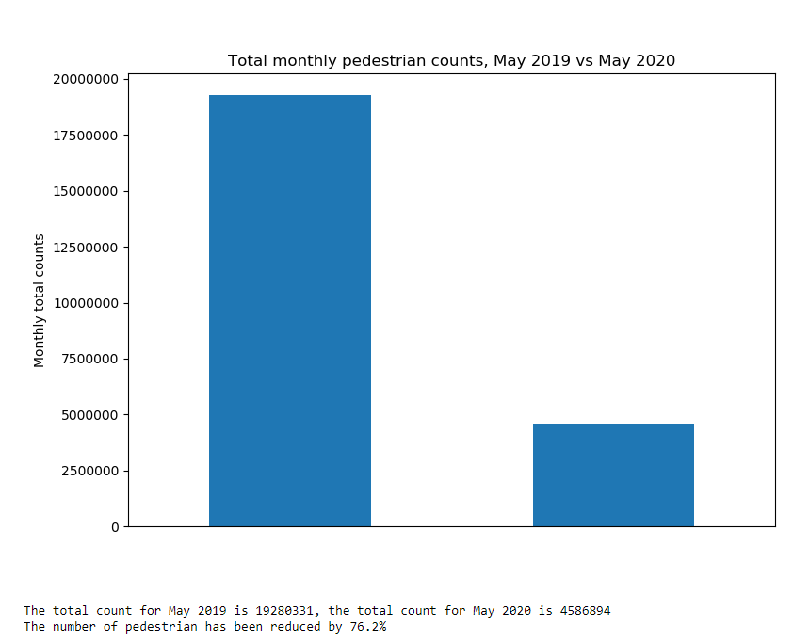
At a high level, what does May 2019 and May 2020 look like?
To understand the overall difference between May 2019 and May 2020, using the data set we had cleansed, we compared the two periods using a simple bar chart to illustrate the difference in volume of foot traffic.
A clearly illustrated by the graph, there was a significant decline (76.2%) in foot traffic between May 2019 and May 20200.

Slide 5
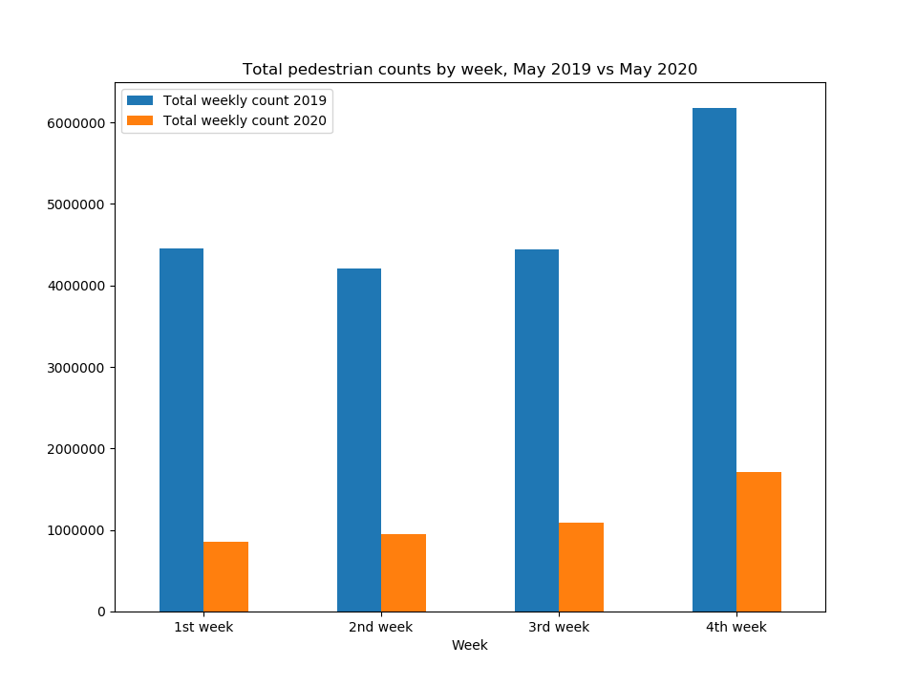
On a week by week basis, we can see steady numbers until the last week of May
Delving a bit further, we looked at the week on week trends in May 2019 and May 2020. Our hypothesis is that towards the end of May 2020, there should be an increase in foot traffic as restrictions were starting to ease. We grouped the foot traffic data by weeks to arrive at a total for each week before graphing into a bar chart. We considered different forms of charts but found this to be the most effective way to show the difference.
The slight increase in foot traffic in the last week of May 20 supported our hypothesis but the same increase was experienced in May 19. Perhaps this is a time when people are enjoying the last of autumn!

Slide 6
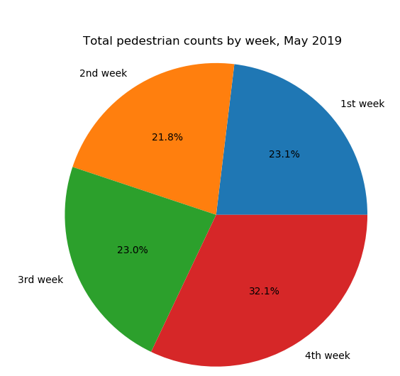
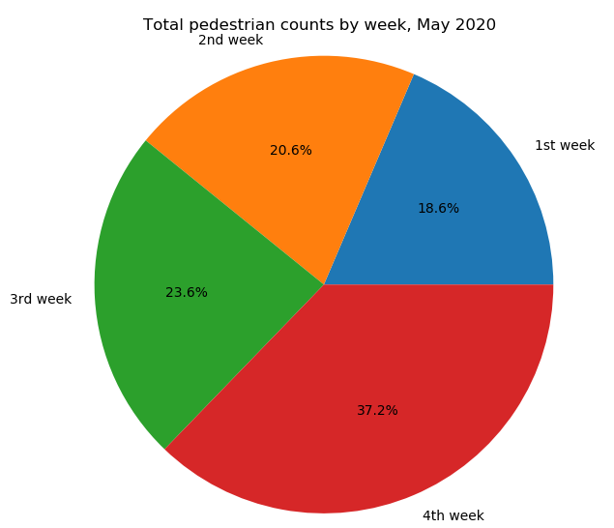
Another view of the week by week analysis was developed showing percentage of foot traffic by week

Slide 7
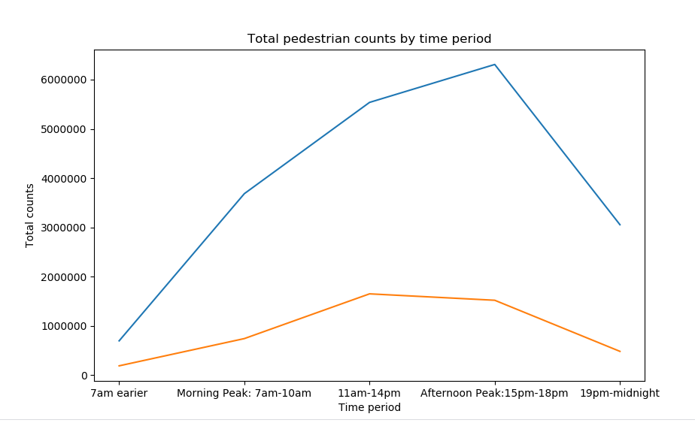
But are people still working in the CBD? Peak period foot traffic says not necessarily
We all know what the peak hour foot traffic is like in Melbourne pre-COVID19. We were keen to explore whether this was reflected in COVID19 foot traffic volumes and, by extension, whether people were still working in the CBD. To perform this analysis, we deemed peak hours to be 7am to 10am and 3pm to 6pm, Monday to Friday. We then grouped the data by time bands to arrive at the totals for each time period. As this was a trend analysis, we used a line graph to show movement and comparison between periods.
It is interesting to note that the trend between May 19 and May 20 are fairly similar. The key difference is in the level of increase and decrease experienced during peak times, i.e. sharper in May 19.
In May 20, our analysis shows there is a significant decline in workers come into and leaving the CBD during peak times. As the volume of foot traffic is relatively stable throughout the day, it may also indicate that the majority of foot traffic are locals living and working in the municipality.

Slide 8
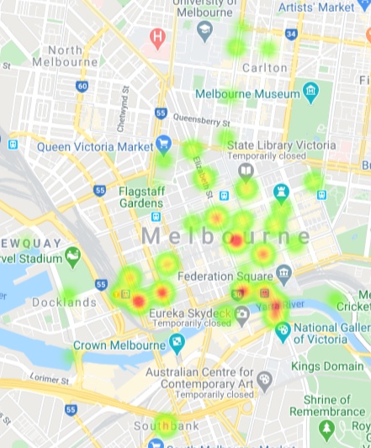
There has been a significant difference in a number of locations
Now that we have established a significant decline in foot traffic, we were curious to see where the decline occurred and whether this correlated to working areas or recreation / entertainment areas.
To perform this analysis, we calculated the difference between May 19 and May 20 for each sensor. As the gmaps function only allows positive weights, we converted all the movements (all negative) into positives using a formula. We then plot the changes into a heatmap.
The five “red” clusters are:
Southern Cross Station
Cnr of King and Collins Street
Bourke Street Mall
Flinders Street Station
Southgate precinct
The locations of the decline shows:
one of the main factors in the reduction of foot traffic is people not coming into the CBD for work purposes (red cluster 1 and 2)
the closure of restaurant and entertainment venues also severely impacted pedestrian numbers (red cluster 3 and 5)

Slide 9
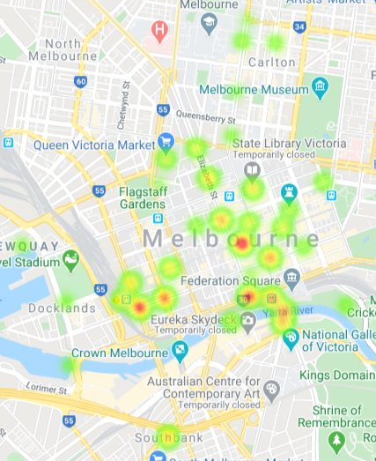
In 2019, there was a general spread of foot traffic with few popular locations
To understand further behavioural trends, we mapped the popularity of locations for 2019 and 2020. This is taking the total volume of foot traffic for each sensor by year, and creating a heatmap based on this summary.
In 2019, the key popular spots were also areas which experienced the highest level of decline in foot traffic.
It is interesting to note the volume of foot traffic in New Quay and University of Melbourne precincts (circled in blue).

Slide 10
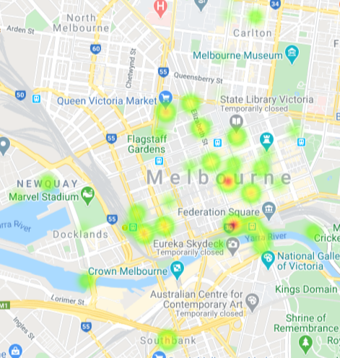
In 2020, locations with essential services and higher residential population were the most popular
To understand further behavioural trends, we mapped the popularity of locations for 2019 and 2020. This is taking the total volume of foot traffic for each sensor by year, and creating a heatmap based on this summary.
The most popular locations in May 20 were Flinders Street Station and Bourke Street Mall. However, the areas which are most popular also have a strong residential population, e.g. New Quay and Queen Victoria Market. This may support the trend identified earlier in the peak hour analysis that foot traffic is a result of those living and working in the municipality.
There is a marked decline of foot traffic in the University of Melbourne precinct as expected due to campuses being closed to students.

